Slide 1
Data and Information
Mr Butler

Slide 2
The Specification
distinguish between data, information and knowledge by using examples;
describe how the quality of the information produced can be affected by the following factors: accuracy, relevance, up to date/currency, completeness, presentation and reliability ;
describe and apply the following data validation methods: range, type, length, format, presence, Modulus 11 check digit and lookup;
understand the purpose of the following data validation methods: check digits; and batch totals (hash and control);
understand the purpose of data verification methods: double entry, proofreading;
explain the limitations of data validation and data verification.

Slide 3
Is there a difference between data and information?
Data consists of raw or unprocessed facts and figures which are not set in a particular context. Therefore it does not have any meaning until it is processed.
When data is processed the result is information which means that it has a context. Information could be summarised as “data with meaning”.
To help understand the difference between data and information we will consider a large clothing shop which consists of a number of departments.

Slide 4
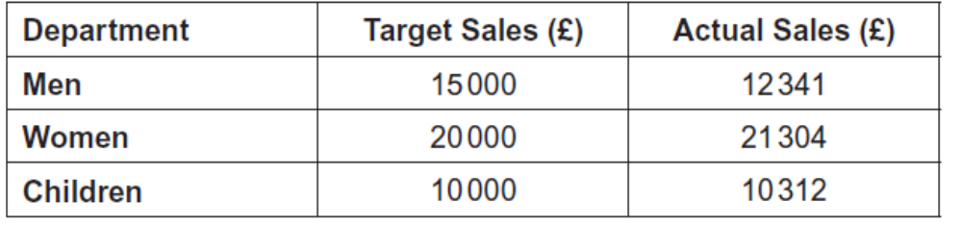
The target sales and the actual sales for each department are shown below.
In the above table 15000 on its own which means it does not have a context is just a sequence of digits, this is what is meant by data.
When we give 15000 a context which in this case would be £15000 is the Target Sales for the Men’s Department it becomes information.

Slide 5
So what’s knowledge then?
Knowledge is the result of applying rules to information to allow decisions to be made or to allow you to interpret the information.
In the example previous, knowledge could be making a decision to plan for further advertising of Men’s clothing due to the sales target not being met as it is below the actual sales whereas the other departments are above Sales Target.

Slide 6
In Summary
Data - Raw facts and figures
On their own have no meaning until they are processed as they have no context
E.G. 45, 68, 87
Information - Data that has been processed
In a context in order to give it meaning ie data with meaning.
E.G. 45, 68, 87 – are the results of Jane’s ICT tests.
Knowledge - Is using information to make decisions.
It is the application of rules to information.
E.G. the ICT teacher can see that Jane is struggling with the content on the first test and needs further help/practice in this area.

Slide 7
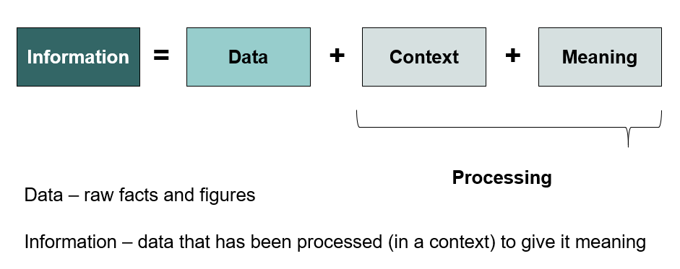
In Summary

Slide 8
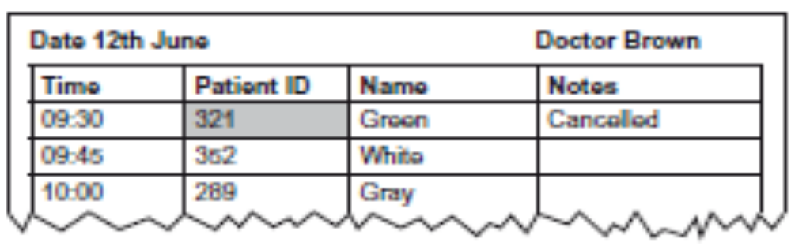
Question Break
Q1) A health centre stores each patient’s medical history in a database. A report of each doctor’s appointments is produced at the start of each day.
(a)By referring to the shaded cell, explain what is meant by:
(i) Data _______________________[2]
(ii) Information _______________ [2]
(b)By referring to the report, explain what is meant by knowledge.
___________________________________________________________ [2]

Slide 9
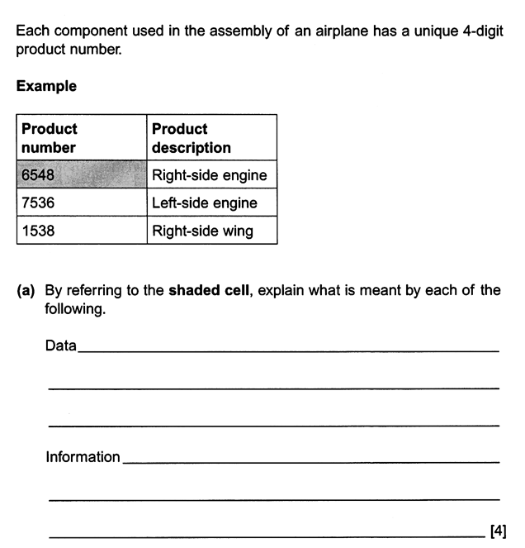
Question Break

Slide 10
Factors that Affect the Quality of Information
Quality
Of Information
depends on ?
Is it
Accurate ?
Is it
Relevant ?
Is it
Presented effectively ?
Is it
Complete ?
Is it
Up to date ?
Is it
Reliable ?
Create an anagram to help you remember the 6 factors which affect the quality of information
R Reliable _________________________
U Up to Date _________________________
P Presented well _________________________
C Complete _________________________
A Accurate _________________________
R Relevant _________________________

Slide 11
Information should be Accurate
The accuracy depends on the use made of the information by a person or organisation. For example the information on a bank statement must be exact to the nearest penny otherwise a customer may complain whereas the weather forecast could be given to the nearest one degree. To ensure information stays accurate thorough error checking must take place and regular updates must be made.
Information should be error free and a true reflection of what it represents. Minor inaccuracies can lead to poor quality decisions being made.
Example - No guarantee the questions will be answered truthfully/correctly.

Slide 12
Information should be Up to date
If information is out of date then it can reduce the quality of information. For example if a school does not update pupil addresses for 5 years then some pupils may not get their school report if they have recently moved house. Real time processing needs data inputted to be processed immediately otherwise it is not up to date. For example when you purchase a flight ticket the bookings file must be updated before the next transaction takes place.
If the information is not processed at the time it was collected, it can be out-dated, which leads to bad decisions if the information has changed.
Example – a report on stock levels will not be up-to-date if it is used to re-order stock two weeks later.

Slide 13
Information should be Complete
This would refer to situations whereby information is missing. For example a school may ask students leaving school to complete a questionnaire with details of their third level course and their student address so as information about the past pupils reunion can be sent next year. If the questionnaires are incomplete such as a missing e-mail address then the student maybe not receive an invitation.
Information should include all the data which the user needs to make their decision.
Example – an answer to a question may have been omitted, this would mean that something would be missing from the information produced. Therefore, it will be difficult to analyse or make a decision.

Slide 14
Information should be Relevant
Having information that is not relevant can be a disadvantage as it adds to the volume which can increase the time taken to find relevant information. Information that is essential in one situation may have no use in another. For example Key Stage three grades may not be relevant for a University application form.
Information should not include data that has no bearing on the user’s informational needs. Too much information could lead to “information overload”
Example – a manager asks for details of one client’s account and receives a report with all clients’ details on it.

Slide 15
Information should be Presented effectively
If Information is not presented in such a way that is difficult to understand then it loses its value. For example information about sales trends in a business would be more effective if a graph is used rather than a text document.
Information should be set out in a clear, accessible format and communicated in a manner that is appropriate for the user.
Example – Terminology on report must be understandable.
Example - Handwriting could be illegible.

Slide 16
Information should be Reliable
The information has been verified and deemed trustworthy. If information comes from a direct source it is more likely to be reliable than information from an indirect source.
For example if information is used for a specific purpose it could be more reliable than if it is used for a different purpose or than originally intended.

Slide 17
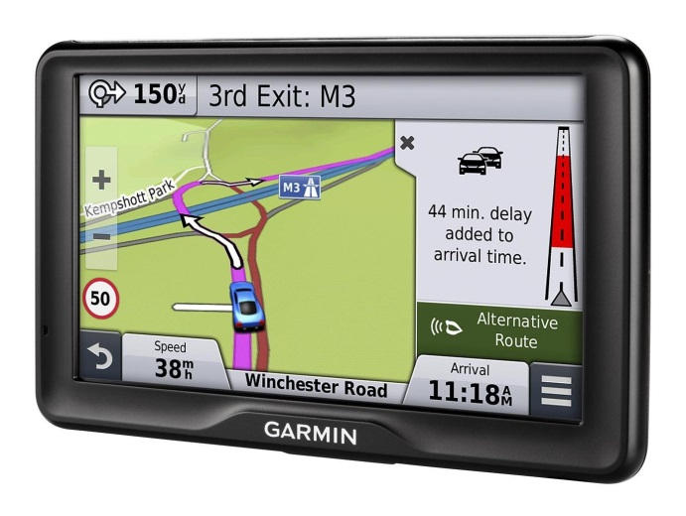
Case Study: Car Navigation
Satellite Navigation Systems provide motorists with Accurate, up to date and relevant information about roads based on data received from satellites.

Slide 18
Question Break
Explain each of the following terms:
  Data
  Information
  Knowledge [3]
List three factors, apart from accuracy, which can affect the quality of information.
  [3]

Slide 19
Question Break
Explain each of the following terms: [3]
Data is raw facts and figures with no meaning or context attached
Information is where data is given a context/or meaning/processed
Knowledge is the application of rules to information to make a decision
List three factors, apart from accuracy, which can affect the quality of information. [3]
  How up to date it is / Completeness / Relevance / Effective presentation / reliability

Slide 20
Direct and Indirect Data Sources
A Direct Data Source refers to data that has been collected from a source document for a specific purpose, for immediate processing
  E.g. An application form for a store card – this was designed to capture relevant data about the shopper to see if they can be issued with a store card.
An indirect data source is used to create information not directly related to the original purpose of the data collection.
  It involves the storage of the data on some medium or storage device for subsequent processing. If this was an indirect data source, this involves using data for a purpose other than was originally intended. There can be legal restrictions – data subjects have to give their consent for the secondary usage.
  E.g. The Application Form for store card could be used as an indirect data source to compile a list of names and addresses for mailing out details about a particular product/service].

Slide 21
Q. The quality of information can be influenced by how up-to-date it is. By referring to a typical invoice, describe two other factors which can influence the quality of information. [4]

Slide 22
Data Validation
Data validation is a check performed by computer software on data as it enters a computer system at the input stage for processing. Its purpose is to trap any data that does not conform to certain rules.
It cannot prove that the data entered is the actual value the user intended.
However it does allow the computer to use a number of techniques to ensure that the data entered will be:
  Sensible
  Reasonable
  Within acceptable boundaries
  Complete
Data is not processed until the validation check has been successful.

Slide 23
Range Check
This will check an input value against an upper limit boundary and a lower limit boundary. If the value falls outside the limits then it is invalid. An example could be month of the year whereby the data entered must be an integer between 1 and 12.
Range checks are therefore used on data made up of numbers or dates which must fall into a particular range. A lower and upper boundary for sensible values is specified. Any values which fall outside of this range will be rejected.
Sometimes there is only one boundary required for a particular field. For example the minimum volume of a cube would be zero cubic centimetres, but there is no maximum volume. When there is only one boundary to check the type of check used is known as a limit check rather than a range check.
Field Name | Lower Boundary | Upper Boundary
Age | 0 | 130
Car Engine Size (L) | 0.5 | 8.0
Month | 1 | 12
Temperature in UK (C) | -20 | 40

Slide 24
Type Check
This ensures that the data item is of a particular data type.
  For example the item price in a stock file is of currency type.
Databases perform type checks automatically on all entered data. When a database is created each field in the database is given a type.
  Whenever data is entered into a field the database will check that it is of the correct type, e.g. alphabetic or numeric.
  If it is not then an error message will be displayed and the data will have to be re-entered. Here are some example field names and appropriate types.
  Notice that a type check is not a very good validation check. Many of the entries in the Valid Data column in the table pass the type check but are clearly incorrect.
Field Name | Type | Valid Data | Invalid Data | Explanation why invalid
Date of Birth | Date | 11/03/96 | 30/02/76 fred
Gender | Alphabetic | Male, Female, Albert | 123 WA2
Shoe Size | Numeric | 12, 2.3, 12323 | 6G house
Postcode | Alphanumeric | W12 6BD

Slide 25
Length Check
This is used to check that the data entered contains a certain number of characters.
For example, a mobile telephone number contains 11 digits.

Slide 26
Format Check (AKA picture or layout checks)
This is used to ensure a data item matches a previously determined pattern and that particular characters have particular values such as letters or digits. For example a date of birth field maybe required to be entered in a predefined format using the pattern DDMMYY.
Format checks can be performed on data entered into a database field. The format that data entered into a field must be in is specified using an input mask. The input mask is made up of special characters which indicate what characters may be typed.
In a particular database the following special characters can be used to define an input mask:
  0 - A number must be typed in this position.
  9 - A number may be typed in this position or it may be left blank.
  L - A letter must be typed in this position.
  l - A letter may be typed in this position or it may be left blank.
  A - A letter or number must be typed in this position.
  a - A letter or number may be typed in this position or it may be left blank.
Here are some input masks that could be used to validate three letter codes, car registration numbers and postcodes.
Input Mask | Purpose | Valid Data | Invalid Data | Explanation why invalid
LLL | Three Letter Code | ABC AND | AB B2H
L990LLL | Car Reg. Number | N912CHG A3HAM | N1234HG N212BT
Ll90 0LL | Postcode | WA149JD M904SJ | WAM49PM WA613H

Slide 27
Presence Check
When entering data into a database some fields maybe optional. This check will not allow certain fields to remain blank.
For example a mobile telephone number may be optional as the person may not own one whereas National Insurance number is required (must be present) on each record in an employee file.
A presence check ensures that data has been entered into a field and that it has not been left blank. e.g. check that a surname is always entered into each record in a database of addresses. This is implemented using a ‘required’ field.

Slide 28
Check Digit
This involves using an extra digit which is added/appended to the numeric data item.
These are used on bar codes placed on products in a typical supermarket or ISBN numbers placed on books.
  It is calculated using the digits from the number and then added to the end of the number.
  When the number is inputted the same calculation takes place and the result is compared to the check digit.
  If the results are the same processing continues.
  If they are not the same, an error has occurred and the numerical value needs to be re-entered. The main way of calculating a check digit is by using Modulus-11 arithmetic.

Slide 29
How to Complete a Modulus 11 Check
Consider the following product number 91167 and calculate the check digit.
STEP 1
Apply Weights
beginning at the right hand digit apply weights. The Check digit has a weighting of 1 and will go at the end
Weight | 6 | 5 | 4 | 3 | 2 | 1
Number | 9 | 1 | 1 | 6 | 7 | X

Slide 30
How to Complete a Modulus 11 Check
Consider the following product number 91167 and calculate the check digit.
STEP 2
Calculate Products
Multiply the weight by the number
Weight | 6 | 5 | 4 | 3 | 2 | 1
Number | 9 | 1 | 1 | 6 | 7 | X
Product | 54 | 5 | 4 | 18 | 14

Slide 31
How to Complete a Modulus 11 Check
Consider the following product number 91167 and calculate the check digit.
STEP 3
Sum the Products
Add the Products together
54 + 5 + 4 + 18 + 14 = 95
Weight | 6 | 5 | 4 | 3 | 2 | 1
Number | 9 | 1 | 1 | 6 | 7 | X
Product | 54 | 5 | 4 | 18 | 14

Slide 32
How to Complete a Modulus 11 Check
Consider the following product number 91167 and calculate the check digit.
STEP 4
Divide the Total by 11
Divide this total by 11 and write down the remainder
54 + 5 + 4 + 18 + 14 = 95
95 / 11 = 8 remainder 7
Weight | 6 | 5 | 4 | 3 | 2 | 1
Number | 9 | 1 | 1 | 6 | 7 | X
Product | 54 | 5 | 4 | 18 | 14

Slide 33
How to Complete a Modulus 11 Check
Consider the following product number 91167 and calculate the check digit.
STEP 5
Weight | 6 | 5 | 4 | 3 | 2 | 1
Number | 9 | 1 | 1 | 6 | 7 | X
Product | 54 | 5 | 4 | 18 | 14
11 minus remainder
95 / 11 = 8 remainder 7
11 – 7 = 4
This means the check digit is 4

Slide 34
Special Cases
It is important to note that there are special cases to the rule Check digit = 11-R.
  If R=1 then check digit = x (when the check digit is 10)
  If R=0 then check digit = 0 (when the check digit is 11)
A check digit system is very good at detecting transposition errors because if you interchange 2 digits then they will have different weights and the sum of the products will be incorrect leading to a data entry error.
Two adjacent characters
are switched/reversed/swapped

Slide 35
Checking the Check Digit
In this case the least significant digit (the Check digit) is given a weighting of 1 and the Sum of the products is calculated as before. This should give an answer which is evenly divisible by 11 (Remainder 0). If the total is not evenly divisible by 11 the number has been input incorrectly.
Alternatively ignore the Check Digit in the number and recalculate it to see if what you get matches the Check Digit in the Question. If they match the Check is Correct, if not it is wrong.

Slide 36
TASK: Modulus 11 Step by Step
Create a tutorial on a single A4 page on how to complete the Modulus 11 check.
You tutorial should include:
  all steps needed to complete the check
  A worked example question (either check the check digit or find out the check digit)
  Any special cases needed
  The back page needs to be blank as we are going to use this for notes on batch totals and look up checks!

Slide 37
Questions:
1: Calculate the check digits for the following numbers
6 7 3 6 9
7 2 9 5 1
8 6 4 2 3
1 5 2 7 8
6 5 4 3 2
2: The following customer account number has been entered into an ordering system. The last digit is a Check Digit. State whether the Check Digit is correct or not and show how you reached this conclusion.
Account Number: 0901369

Slide 38
Past Paper Questions
A Product Code includes a modulus-11 check digit.
Q. Explain how a check digit can be used to detect a transposition error.
_________________________________________________________________________________________________________________________________________________________________________________________________________________________________________________________________________________________________________________________________________________________________________________________________________________________________________________________________________________________________________________________________________________________ [4]
Q. Show that 13217 is an invalid Product Code
_________________________________________________________________________________________________________________________________________________________________________________________________________________________________________________________________________________________________________________________________________________________________________________________________________________________________________________________________________________________________________________________________________________________ [4]

Slide 39
Look up Check
This method uses a lookup table. The data value entered is compared against a stored list of data values looking for a match. If a match is found the data value is valid otherwise it is invalid.
For example when a product code is looked up in a stock file to confirm such an item exists.

Slide 40
Batch Totals
Some information systems process data that is entered into them in batches from documents. These systems typically use batch processing. When data is entered in batches there are two extra types of error that may occur:
  A document may be accidentally missed out.
  The data on a document is entered twice.
Batch totals are used when data is entered in batches to identify if one of these types of error occurs. These can be hash totals or control totals.
Before the information on the documents is entered the user counts how many documents there are. This is the batch total.

Slide 41
Batch Totals
As the data is entered the computer counts how many documents the data is typed from. After the data has been entered the total that was manually calculated is compared to the computer generated total. If the two differ then a document has been missed or some data has been entered twice.
Hash totals are more sophisticated than batch totals. They can be used to spot missed out or doubly entered documents and can also spot more complex errors such as one document being entered twice at the same time as another is missed out. A particular item on the batch of documents that must be entered is chosen. e.g. Hours Worked. The values of this item for each document that is to be input will be added up manually by the user. The total that is calculated is known as the hash total.
The data on the documents will then be entered. The computer will calculate the same total automatically on the chosen item. If the computer calculated total and the manually calculated total differ then a mistake has occurred during data entry.
If a batch hash or control total identifies an error then the user will have to go back through all of the documents, checking which have been entered and which have not.

Slide 42
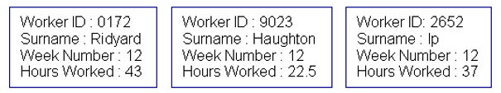
Batch Totals
Example : These three documents recording the number of hours worked by the employees at a firm are to be entered in a batch (note that in a real system the number of documents would be larger than this):
  The batch total would be 3 as there are three documents.
  If the field Hours Worked was chosen to calculate a control total then the control total would be 102.5 as 43+22.5+37=102.5
  If the field Worker ID was chosen to calculate a hash total then the hash total would be 11847 as 0172+9023+2652=11847
The chosen totals would be calculated manually by the user before the data was entered. Probably only one total would be used. Now suppose that the data was entered but by mistake the user missed out the middle document.
  The computer calculated batch total would be 2.
  If the field Hours Worked was chosen to calculate a control total then the computer calculated control total would be 80 as 43+37=80
  If the field Worker ID was chosen to calculate a hash total then the computer calculated hash total would be 2824 as 0172+2652=2824
All of the different methods would spot the mistake as the user calculated and computer calculated totals differ. Suppose instead that the user missed out the middle document but entered the last document twice. The computer calculated totals would then be:
  Computer batch total is 3.
  Computer control total on Hours Worked is 117 as 43+37+37=117.
  Computer hash total on Worker ID is 5476 as 0172+2652+2652=5476.
The batch total would not spot the mistake as the number of documents entered is correct (3). The hash totals would however spot it as they differ from the user calculated ones.

Slide 43
Batch Totals: Summary
Batch totals therefore refer to the total value of one or more fields in a batch of data. They are calculated in advance, normally by humans, and then compared with the total as calculated by the computer. We referred to a batch total as either a control total or a hash total.
If the batch total calculated is meaningful such as the total monetary value of all orders during a transaction period then it is referred to as a control total. If the batch total calculated has no clear meaning such adding all the dates of orders together to produce a total of dates this is referred to a hash total.

Slide 44
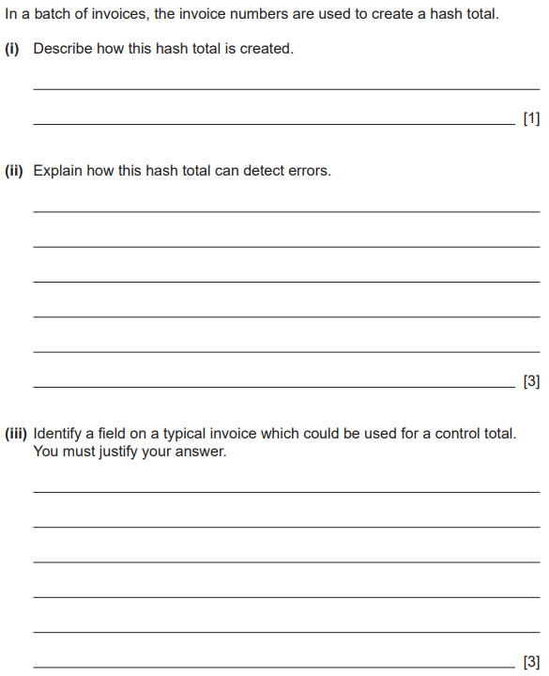
Questions: Batch Totals
Notes:
this question is in notes booklet

Slide 45
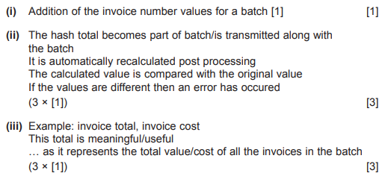

Slide 46
Data Verification
Data verification is used to confirm the integrity of data entered into the system. It ensures the data is consistent and that it has not been corrupted. Its purpose is to check that data being input has been accurately transferred from the source document to the computer.
The following methods are used:
  Double Entry
  Proof Reading

Slide 47
Double Entry
This involves entering the data twice into the computer system and the computer will check both copies to ensure there are no differences. Any differences will be manually corrected.

Slide 48
Proof Reading
This is also known as visual checking. This involves the user checking data entered into the computer system perfectly matches the source of the data.
If the user sees that the data is correct then they confirm this to the computer.

Slide 49
Class Question: Mark Scheme
A book can be reserved at a library by completing a form. The librarian keys the data from these forms into a database.
Explain how double entry can be used to detect errors in this case.
The data is keyed in twice
The computer/system
… checks that both versions match/ae the same
[3]

Slide 50
Class Question:
A book can be reserved at a library by completing a form. The librarian keys the data from these forms into a database.
Explain how double entry can be used to detect errors in this case.
[3]

Slide 51
Limitations of Data Validation and Verification
Data validation and verification do not guarantee that all data entered will be correct and error free. There are limitations in using either of these methods.
  When using a range check for the day of a typical month, it is possible that the day is valid but incorrect such as the day was entered as 13 and should be 31.
  This is referred to as a transposition error. When using a presence check if data exists in the given field it will be valid but the actual data could be incorrect such as a forename rather than a surname.
  In using a lookup table a data value may be valid but is not stored in the lookup table and therefore it will be classified as invalid by the computer. This will require the lookup values stored in the table being updated regularly to ensure the data validation check is not limited.
When using data verification a limitation could be the data source. If the data source is unreliable and the data entered is checked against this source it will cause a problem.
  The user may proofread and seeing a match with what is on the source document with what is displayed on the screen and then they will confirm this to the computer as being correct when the actual source is incorrect.

